Slide 1


Slide 2

Coffee
Break
Sponsor

Slide 3

Coffee
Break
Sponsor

Slide 4

Coffee
Break
Sponsor

Slide 5

KEYNOTE SPEAKER SPONSOR
Keithly-Williams
Seeds

Slide 6

EVENT SPONSOR

Slide 7
Ag Seeds Unlimited
Bejo Seeds Inc.
California Crop Improvement Association
Central Valley Seeds
Champion Seed Co.
Germains Seed Technology
Gowan Seed Co.
Holaday Seed Co.
InterWest Insurance Services
Keithly-Williams Seeds
Monsanto Co.
Radicle Seed Co.
Sakata Seed America
Santa Maria Seeds
Seed Dynamics
TS&L Seed Co.
Top Notch Seeds Inc.
Tozer Seeds America
White Seed Co.
Golf Hole Sponsors

Slide 8
American Takii Inc.
Barkley Seed
California Crop Improvement Association
Central Valley Seeds
Champion Seed Co.
Condor Seed Production
Estancia Winery
Eurofins BioDiagnostics
Gowan Seed Co.
L.A. Hearne Co.
Monsanto Co.
Radicle Seed Co.
Ransom Seed Laboratory
S & W Seed Co.
Sakata Seed America
Top Notch Seeds Inc.
White Seed Co.
Bocce ball Sponsors

Slide 9
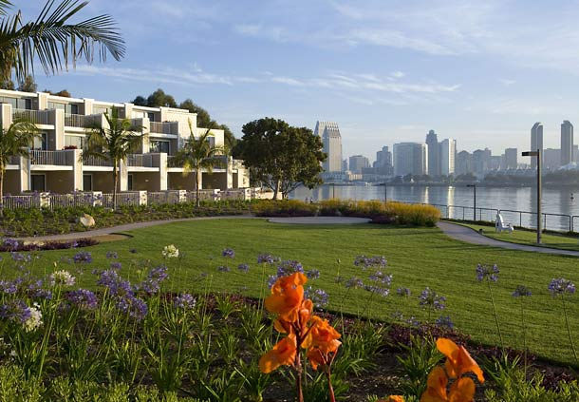
^{Upcoming Date}
^{CSA Annual Convention}
Marriott Coronado Island Resort & Spa
^{March 5-8, 2016}

